Slide 1
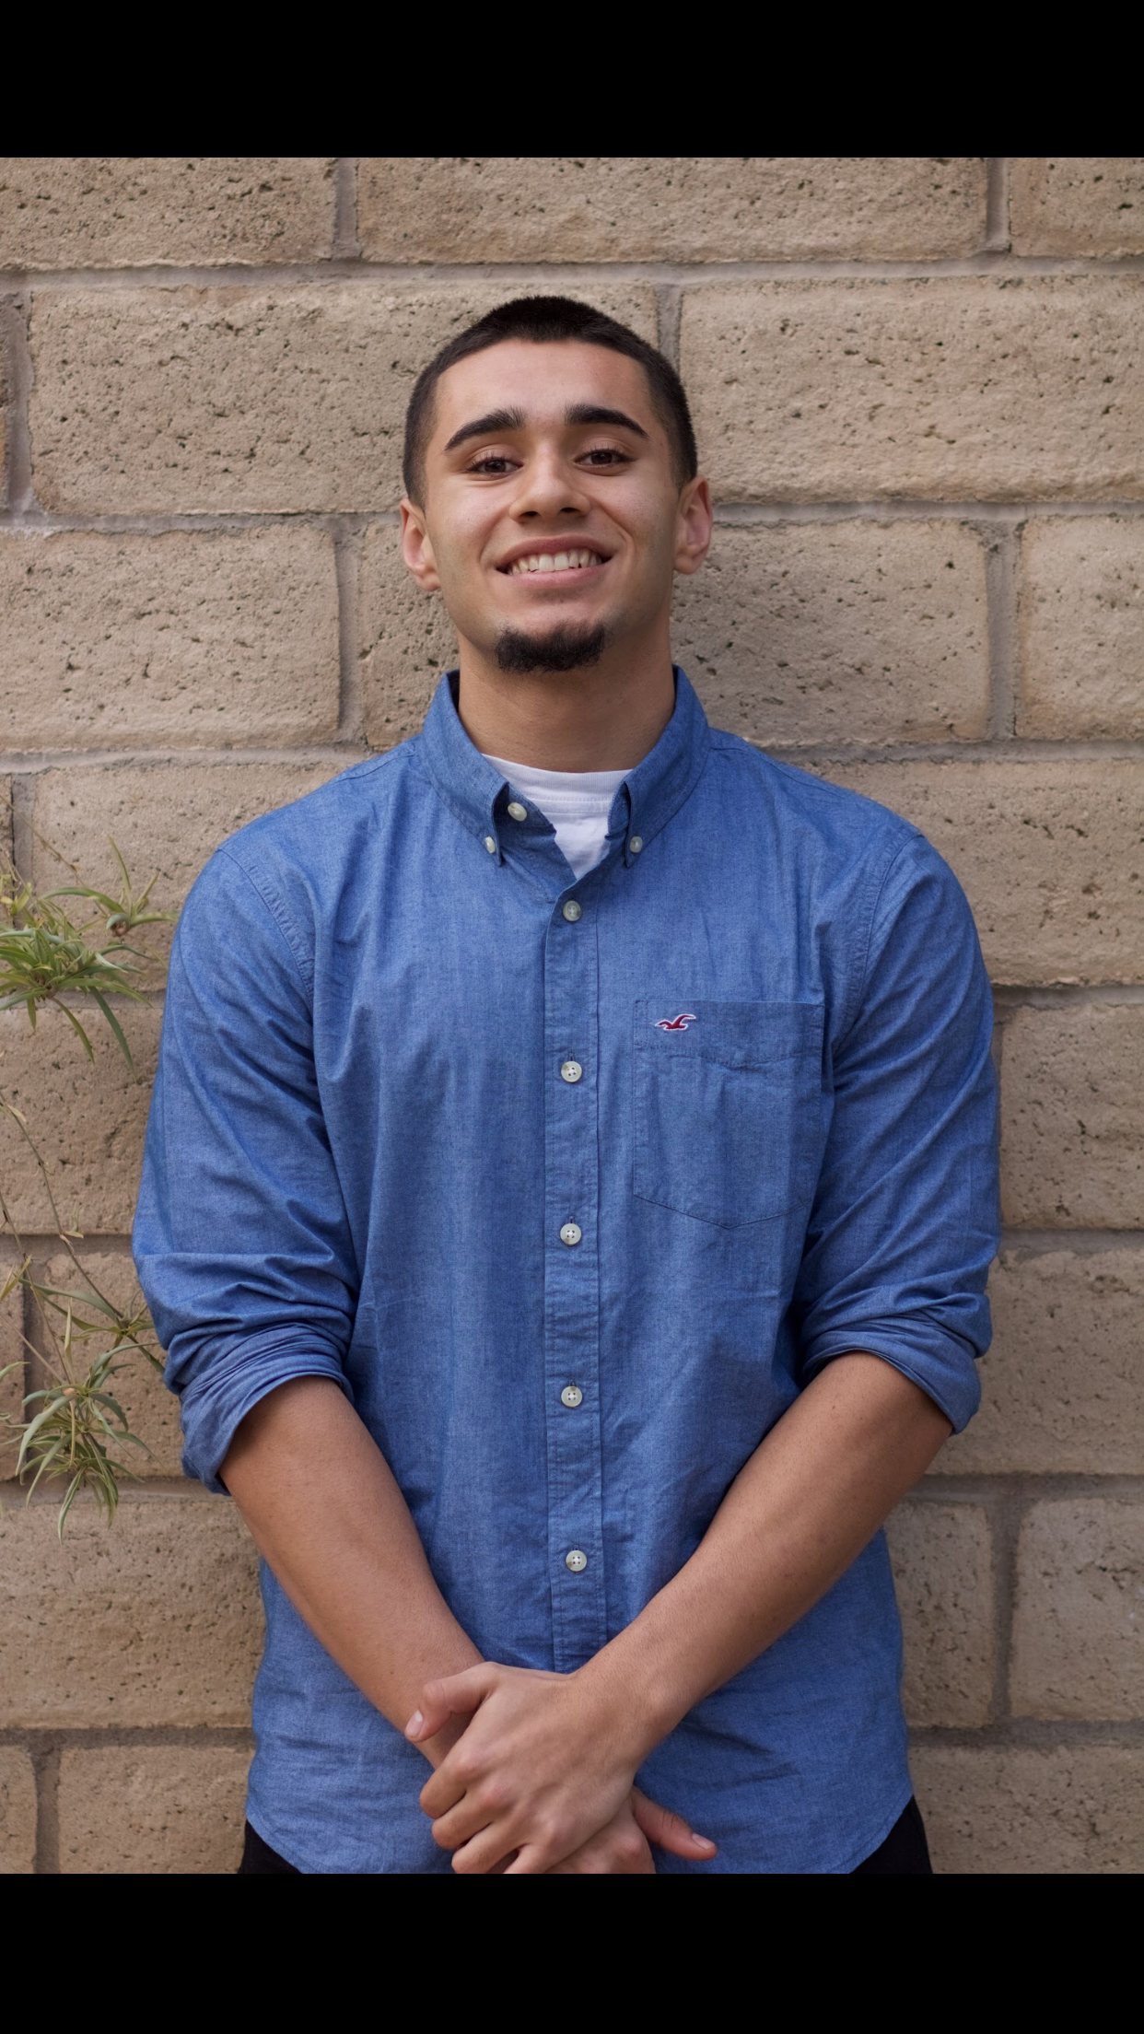
Javier Venegas
Class of 2017

Slide 2
About me
I am 17 years old
Family of 6
Work at parents business
Like to workout
Notes:
Soo a little bit about me is i'm 17 years old i work at my parents business here in town we sell many things like clothes mony orders and we can send money to mexico
I live with my parents i have t younger brothers and an older sister
My freshman year my friend invite me to workout and i instantly fell in love

Slide 3
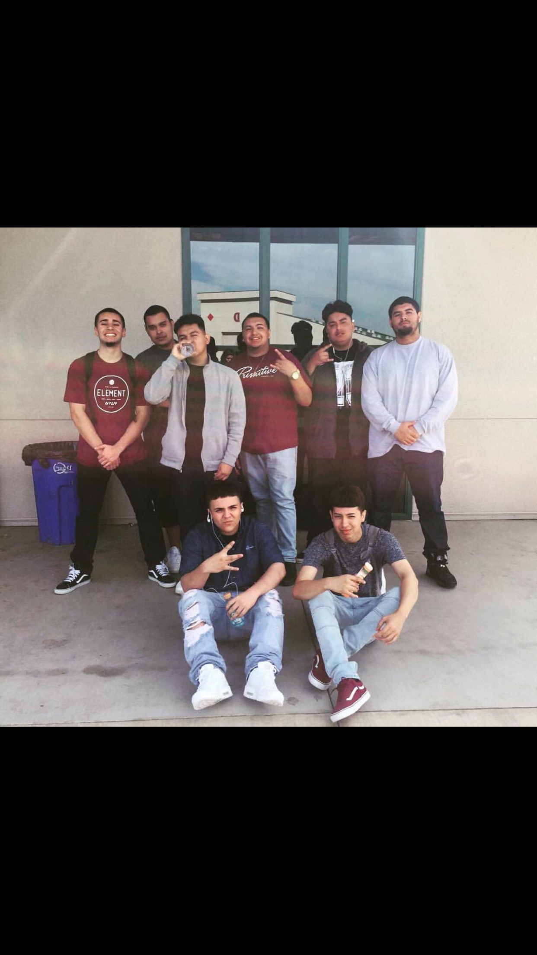
High school experience
Met many new people and made many friends
The PBS system has been successful for me because i have been able to finish classes weeks or even months ahead.

Slide 4
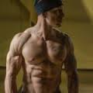
Job shadow
Anthony Gonzalez
Personal Trainer
Requires patience, experience, and good communication skills

Slide 5
Pathway
Residential Construction
Lost interest
Entruepernuer
Notes:
Entering high school i wasnt really sure what i wanted to do

Slide 6
Post high school plans
Go to COS
Transfer to fresno state
Open up my own small business

Slide 7
Leaving Lindsay High School
Thankful for my supportive parents
Performance based system
Reality check

Slide 8
